Slide 1
Unit IV
UNSUPERVISED LEARNING: CLUSTERING AND PATTERN DETECTION
INT234:PREDICTIVE ANALYTICS

Slide 2
Topics
Unsupervised learning
K-Means Clustering
  Kmeans clustering intuition
  K-means random initialization trap
  K-means selecting number of clusters
Hierarchical Clustering (Divisive, Agglomerative)
  Types of Linkages (Single, Complete, Average, Centroid)
  Association Rules
  Finding Patterns
  Market Basket Analysis Using Association Rules

Slide 3
0. Unsupervised learning
Unsupervised learning is a branch of machine learning where
algorithms discover patterns and structures within unlabeled data without explicit guidance or predefined output labels.
learns from data without human supervision.
helping to turn data into insights that can improve efficiencies, reduce costs, and better inform decision-making.
uses self-learning algorithms.
better suited for more complex processing tasks

Slide 4
0.1 Unsupervised machine learning methods
Clustering: exploring raw, unlabeled data and breaking it down into groups based on similarities or differences
Association: rule-based approach to reveal interesting relationships between data points in large datasets (discover correlations).
  Ex. products frequently purchased together.
Dimensionality reduction: Reduces the number of features, or dimensions, in a dataset. Eg.
  principle component analysis (PCA),
  singular value decomposition (SVD).
Source: https://cloud.google.com/discover/what-is-unsupervised-learning?hl=en

Slide 5
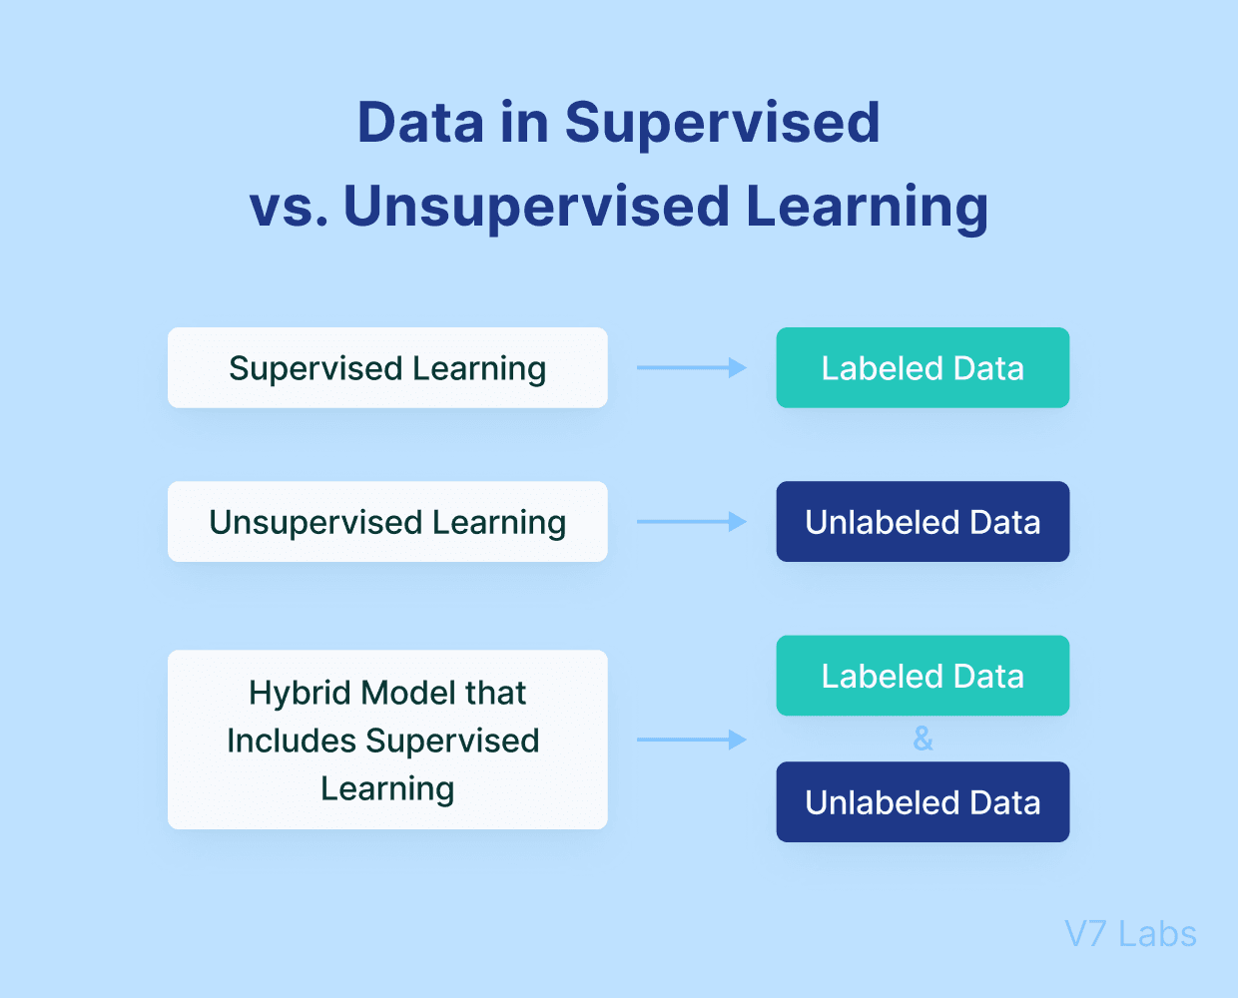

Slide 6
UNSUPERVISED LEARNING
CLUSTERING AND PATTERN DETECTION

Slide 7
Scenario
Have you ever spent time watching a large crowd?
If so, you are likely to have seen some recurring personalities.
Perhaps a certain type of person, identified by a freshly pressed suit and a briefcase, comes to typify the "fat cat" business executive.
A twenty-something wearing skinny jeans, a flannel shirt, and sunglasses might be dubbed a "hipster," while a woman unloading children from a minivan may be labeled a "soccer mom.“
Of course, these types of stereotypes are dangerous to apply to individuals, as no two people are exactly alike.
Yet understood as a way to describe a collective, the labels capture some underlying aspect of similarity among the individuals within the group.
Notes:
Unsupervised learning is a type of machine learning in which models are trained using unlabeled dataset and are allowed to act on that data without any supervision.Unsupervised learning cannot be directly applied to a regression or classification problem because unlike supervised learning, we have the input data but no corresponding output data. The goal of unsupervised learning is to find the underlying structure of dataset, group that data according to similarities, and represent that dataset in a compressed format.

Slide 8
Clustering
Clustering is an unsupervised machine learning task that automatically divides the data into clusters, or groups of similar items.
It does this without having been told how the groups should look ahead of time.
As we may not even know what we're looking for, clustering is used for knowledge discovery rather than prediction.
It provides an insight into the natural groupings found within data.

Slide 9
Clustering …
Without advance knowledge of what comprises a cluster, how can a computer possibly know where one group ends and another begins?
The answer is simple.
Clustering is guided by the principle that items inside a cluster should be very similar to each other, but very different from those outside.
The definition of similarity might vary across applications, but the basic idea is always the same - group the data so that the related elements are placed together.

Slide 10
Clustering application
The resulting clusters can then be used for action. For instance, you might find clustering methods employed in the following applications:
• Segmenting customers into groups with similar buying patterns for targeted marketing campaigns
• Detecting anomalous behavior, such as unauthorized network intrusions,
• Simplifying extremely large datasets by grouping features with similar values into a smaller number of homogeneous categories

Slide 11
Clustering as a machine Learning Task : Example
Suppose you were organizing a conference on the topic of data science.
To facilitate professional networking and collaboration, you planned to seat people in groups according to one of three research specialties:
  computer and/or database science,
  math and statistics, and
  machine learning.
Unfortunately, after sending out the conference invitations, you realize that you had forgotten to include a survey asking which discipline the attendee would prefer to be seated with.

Slide 12
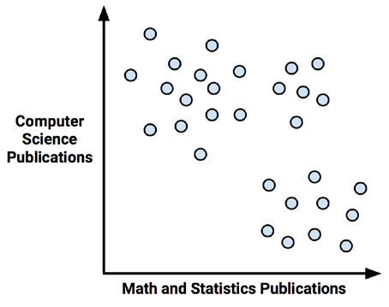
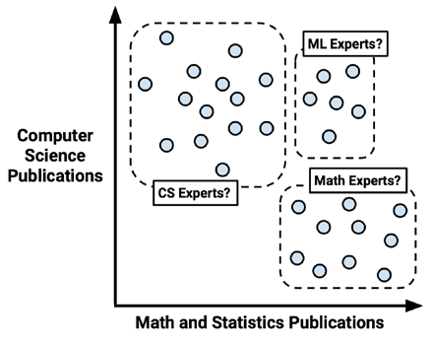
As expected, there seems to be a pattern.
We might guess that the upper-left corner, which represents people with many computer science publications but few articles on math, could be a cluster of computer scientists.
Following this logic, the lower-right corner might be a group of mathematicians.
Similarly, the upper-right corner, those with both math and computer science experience, may be machine learning experts

Slide 13
K-Means Clustering Algorithm
The k-means algorithm assigns each of the n examples to one of the k clusters, where k is a number that has been determined ahead of time.
The goal is to minimize the differences within each cluster and maximize the differences between the clusters.
The algorithm essentially involves two phases.
First, it assigns examples to an initial set of k clusters.
Then, it updates the assignments by adjusting the cluster boundaries according to the examples that currently fall into the cluster.
The process of updating and assigning occurs several times until changes no longer improve the cluster fit.
At this point, the process stops and the clusters are finalized.

Slide 14
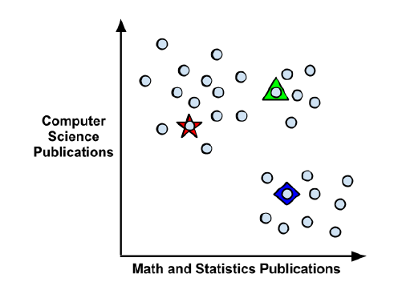
Step1: Using distance to assign and update cluster
The k-means algorithm begins by choosing k points in the feature space to serve as the cluster centers.
These centers are the catalyst that spurs/encourage the remaining examples to fall into place.
As we hope to identify three clusters, according to this method, k = 3 points will be selected at random.
These points are indicated by the star, triangle, and diamond in the diagram (right).

Slide 15
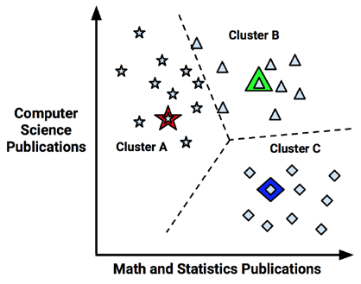
Step2: assignment phase
As shown in the diagram (right), the three cluster centers partition the examples into three segments labeled Cluster A, Cluster B, and Cluster C.
The dashed lines indicate the boundaries for the Voronoi diagram created by the cluster centers.
The Voronoi diagram indicates the areas that are closer to one cluster center than any other; the vertex where all the three boundaries meet is the maximal distance from all three cluster centers.
Using these boundaries, we can easily see the regions claimed by each of the initial k-means seeds.

Slide 16
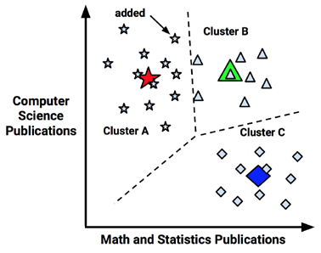
Step3: update phase
Now that the initial assignment phase has been completed, the k-means algorithm proceeds to the update phase.
The first step of updating the clusters involves shifting the initial centers to a new location, known as the centroid, which is calculated as the average position of the points currently assigned to that cluster.
The diagram illustrates how as the cluster centers shift to the new centroids, the boundaries in the Voronoi diagram also shift and a point that was once in Cluster B (indicated by an arrow) is added to Cluster A.

Slide 17
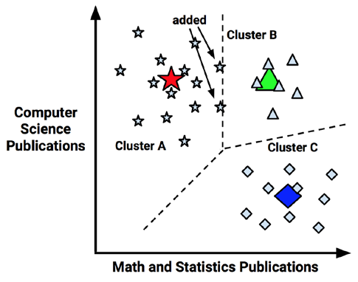
updating the cluster boundaries
As a result of this reassignment, the k-means algorithm will continue through another update phase.
After shifting the cluster centroids, updating the cluster boundaries, and reassigning points into new clusters (as indicated by arrows), in the figure.

Slide 18
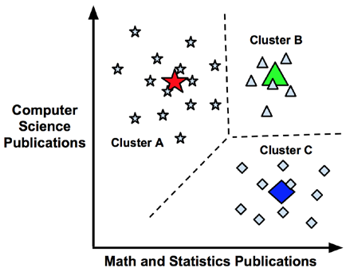
Because two more points were reassigned, another update must occur, which moves the centroids and updates the cluster boundaries.
However, because these changes result in no reassignments, the k-means algorithm stops.
The cluster assignments are now final.

Slide 19
1. K-Means Clustering
📌 Intuition
It partitions data into K clusters by minimizing the intra-cluster variance.
It iteratively:
Assigns each point to the nearest centroid
Updates centroids based on current cluster members

Slide 20
Clustering : 09_0_Kmean_titanic.py
The KMeans algorithm groups passengers into clusters (n_clusters=2) based on patterns in:age, class, fare, and sex.
The crosstab shows how these clusters align with actual survival labels.
  e.g., Cluster 0 might mostly be survivors, Cluster 1 mostly non-survivors.
KMeans doesn’t know anything about survival (it’s unsupervised).
It only looks at patterns in the features you provide (Age, Fare, Sex, Pclass).
When you set n_clusters=3, KMeans will try to split the passengers into 3 distinct groups.[3rd class,1st class, medium fare)

Slide 21
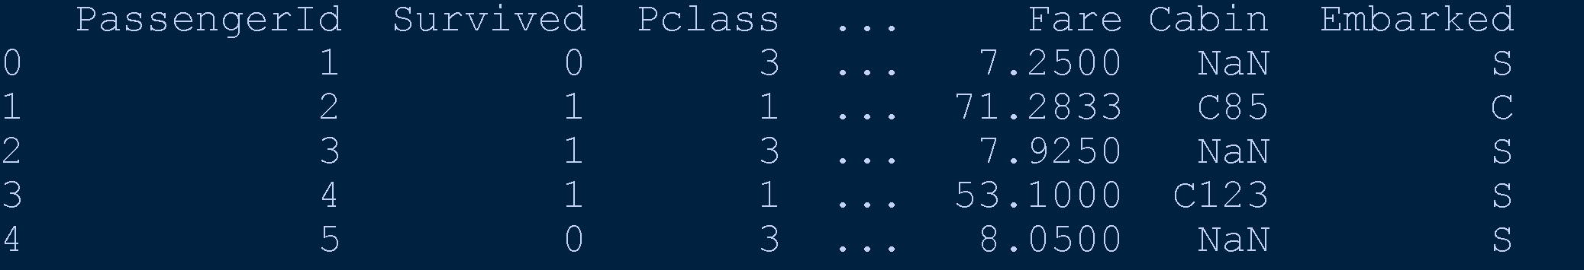
# Step 1: Import Libraries & Dataset
import pandas as pd
import matplotlib.pyplot as plt
from sklearn.cluster import KMeans
from sklearn.preprocessing import StandardScaler
# Load Titanic dataset
#url = "https://raw.githubusercontent.com/datasciencedojo/datasets/master/titanic.csv"
url ='titanic.csv'
data = pd.read_csv(url)
print(data.head())
# Step 2: Select & Preprocess Features
df = data[['Pclass', 'Age', 'Fare', 'Sex']].copy()
# Handle missing values
df['Age'] = df['Age'].fillna(df['Age'].median())
# Encode 'Sex' (male=0, female=1)
df['Sex'] = df['Sex'].map({'male':0, 'female':1})
# Feature scaling
scaler = StandardScaler()
X = scaler.fit_transform(df)

Slide 22
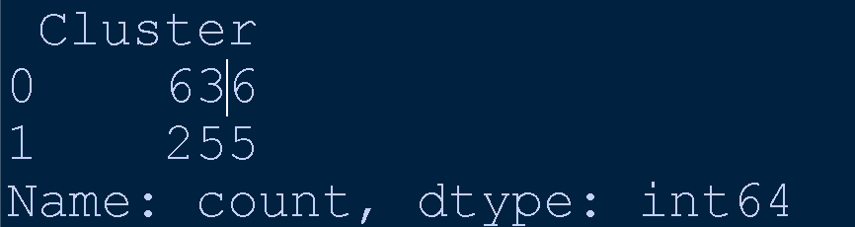
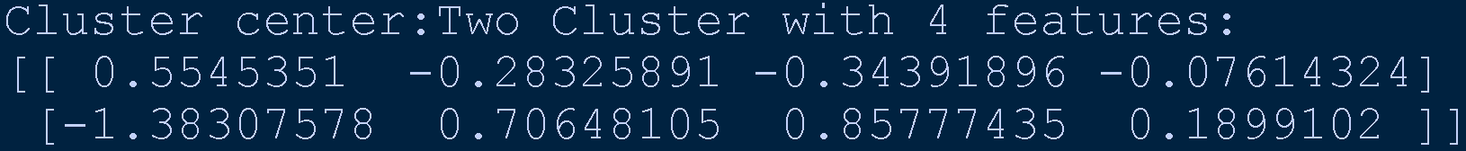
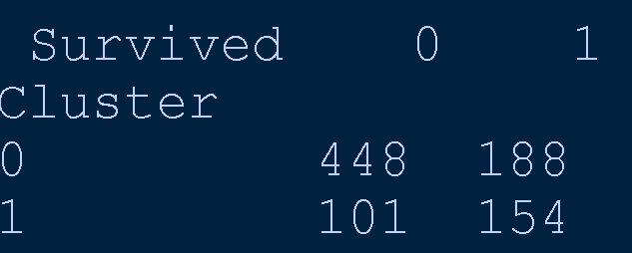
# Step 3: Apply KMeans clustering
kmeans = KMeans(n_clusters=2, random_state=42)
df['Cluster'] = kmeans.fit_predict(X)
print(df['Cluster'].value_counts())
# This will give the average values of each feature for each cluster.
# 👉 From this, you can interpret which features separate the groups.
print(kmeans.cluster_centers_)
# Step 4: Compare clusters with Actual Survival
df['Survived'] = data['Survived']
ct = pd.crosstab(df['Cluster'], df['Survived'])
print(ct)
#Step 5: Visualization (2D for simplicity)
plt.figure(figsize=(8,6))
plt.scatter(df['Age'], df['Fare'], c=df['Cluster'], cmap='coolwarm', alpha=0.6)
plt.xlabel("Age")
plt.ylabel("Fare")
plt.title("K-Means Clustering on Titanic (Age vs Fare)")
plt.show()

Slide 23
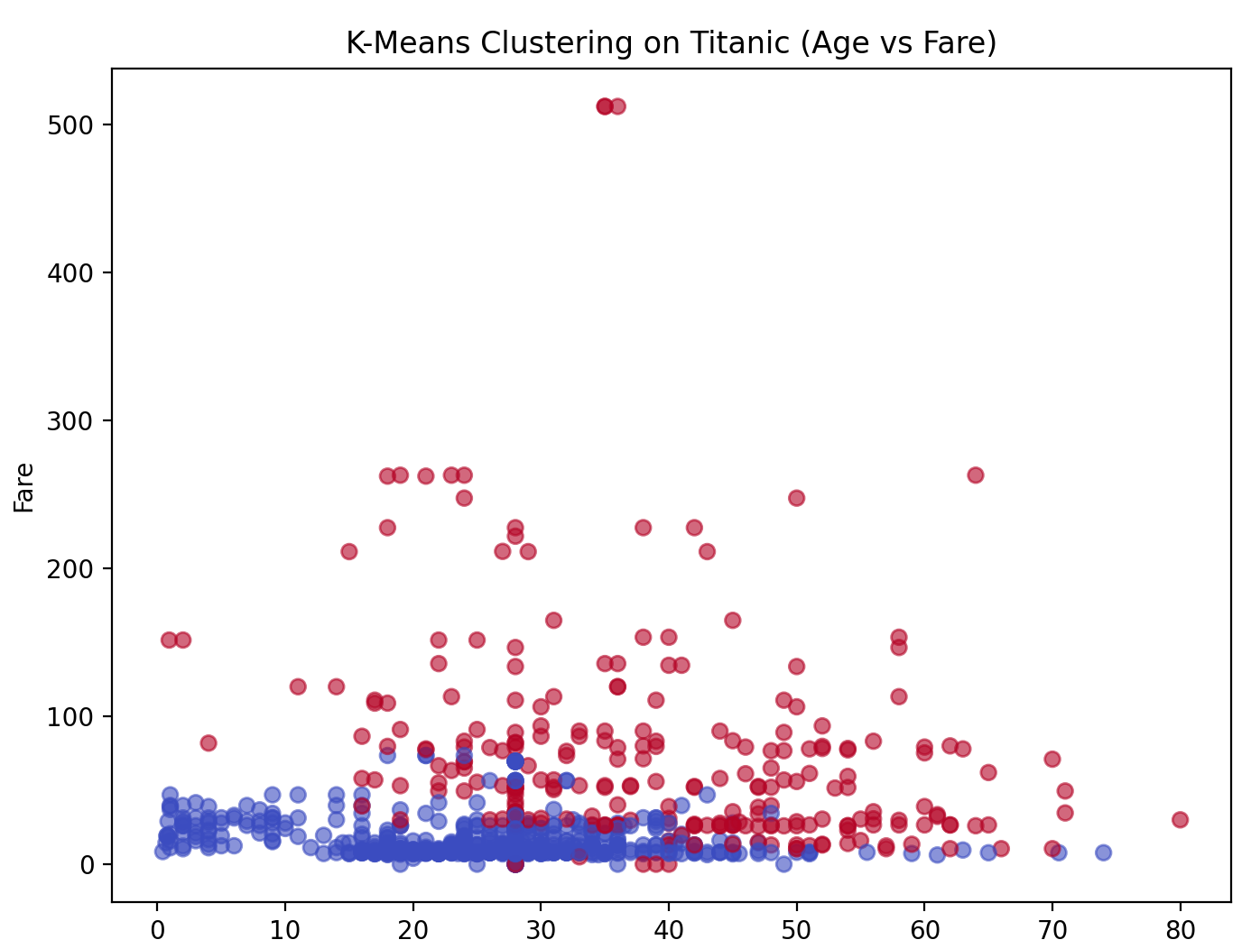

Slide 24
✅Program observations
KMeans uses all features you pass into fit_predict().
It doesn’t “choose” one — it considers the distance across all dimensions.
To see what drives the clusters:
  Look at cluster centroids (kmeans.cluster_centers_)
  Or use PCA to reduce dimensions for visualization.
In n_clusters=2, we cannot be “sure” that clusters are survival-based.
We can only validate afterward by comparing cluster assignments with survival labels.
So, even though KMeans didn’t know survival, the clusters roughly align with survival groups because features (sex, fare, class) are strongly linked to survival chances.

Slide 25
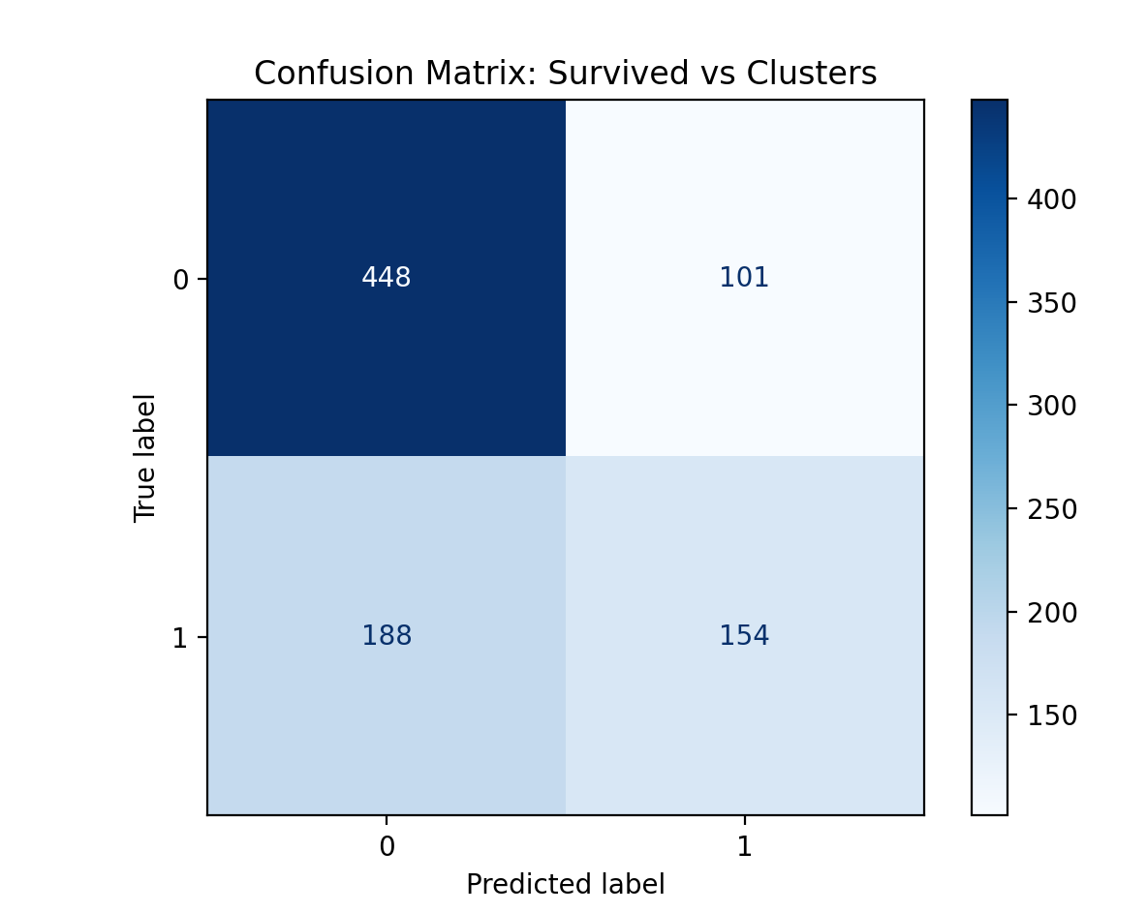
# Step 6: Confusion Matrix [Optional]
from sklearn.metrics import confusion_matrix, ConfusionMatrixDisplay
cm = confusion_matrix(df['Survived'], df['Cluster'])
disp = ConfusionMatrixDisplay(confusion_matrix=cm, display_labels=[0,1])
disp.plot(cmap="Blues")
plt.title("Confusion Matrix: Survived vs Clusters")
plt.show()

Slide 26
2. K-Means Initialization Trap
⚠️ Problem
The K-Means Initialization Trap, also known as the Random Initialization Trap.
It refers to a common pitfall in the K-Means clustering algorithm where poor initial placement of centroids leads to suboptimal or inconsistent clustering results.

Slide 27
2.1🧠 Causes of Trap
K initial centroids if these centroids are poorly chosen:
The algorithm may converge to local minima, not the best possible clustering.
Different runs on the same data can yield different cluster assignments.
Clusters may be misaligned with the true structure of the data.

Slide 28
2.2 📉 Example Scenario
Imagine clustering customer data into three groups.
If two centroids are initialized too close together, they might end up capturing the same cluster, leaving the third cluster poorly represented or missed entirely.

Slide 29
2.3 🛠️ How to Avoid It
The most popular solution is K-Means++, which improves initialization by:
Selecting the first centroid randomly.
Choosing subsequent centroids to be far apart from existing ones.
This reduces the chance of poor starting points and improves clustering consistency
Use kmeans++ (default in scikit-learn) to spread initial centroids.
  KMeans(n_clusters=4, init='k-means++', random_state=42)
Instead of
  KMeans(n_clusters=2, random_state=42)

Slide 30
2.3 contd… init='k-means++'
Use kmeans++ (default in scikit-learn) to spread initial centroids.
  KMeans(n_clusters=4, init='k-means++', random_state=42)
Instead of
  KMeans(n_clusters=2, random_state=42)
KMeans++ Doesn’t Guarantee Different Results
KMeans++ improves the chance of better clustering, but if the data is well-separated or low-dimensional, it might still converge to similar clusters as random init.

Slide 31
2.4 Example 2 (09_1_age_income_KMean.py)
import pandas as pd
import numpy as np
import matplotlib.pyplot as plt
#import dataset
data=pd.read_csv("Mall_Customers.csv")
print(data.head())
#Plotting the scatter plot
# Create figure with 3 subplots
fig, axes = plt.subplots(1, 3, figsize=(18, 5))
X=data[['Age']]
y=data['Annual Income (k$)']
axes[0].scatter(X,y)
axes[0].set_title("Age vs Annual Income")
axes[0].set_xlabel("Age")
axes[0].set_ylabel("Annual Income (k$)")
Mall_Customers.csv
CustomerID
Genre
Age
Annual Income (k$)
Spending Score (1-100)
Modified from Source:
https://zepanalytics.com/blogs/k-means-clustering

Slide 32
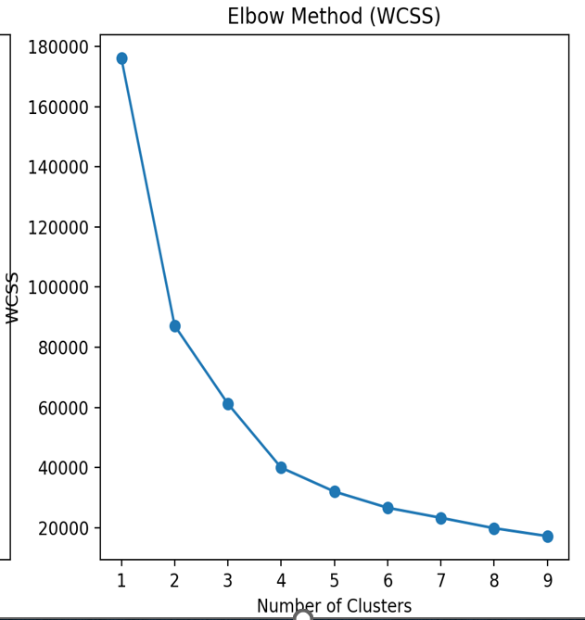
WITHIN CLUSTERS SUM OF SQUARES(WCSS)
from sklearn.cluster import KMeans
# WITHIN CLUSTERS SUM OF SQUARES(WCSS)
# cols = ['Age’] use multiple features
cols = ['Age', 'Annual Income (k$)']
X = data[cols]
wcss=[]
for i in range(1,10):
km=KMeans(n_clusters=i)
km.fit(X)# 2D-single list of column names.
wcss.append(km.inertia_)
axes[1].plot(range(1,10),wcss, marker='o')
axes[1].set_title("Elbow Method (WCSS)")
axes[1].set_xlabel("Number of Clusters")
axes[1].set_ylabel("WCSS")
Method to decide to choosing the number of cluster…

Slide 33
KMeans
#use k predicted form WCSS
km=KMeans(n_clusters=5)
data['Cluster'] = km.fit_predict(X)
#Step 5: Visualization (2D for simplicity)
axes[2].scatter(data['Age'], data['Annual Income (k$)'], c=data['Cluster'], cmap='coolwarm', alpha=0.6)
axes[2].set_xlabel("Age")
axes[2].set_ylabel("Annual Income (k$)")
axes[2].set_title("K-Means Clustering (Age vs Annual Income )")
# Final layout
plt.tight_layout()
plt.show()

Slide 34
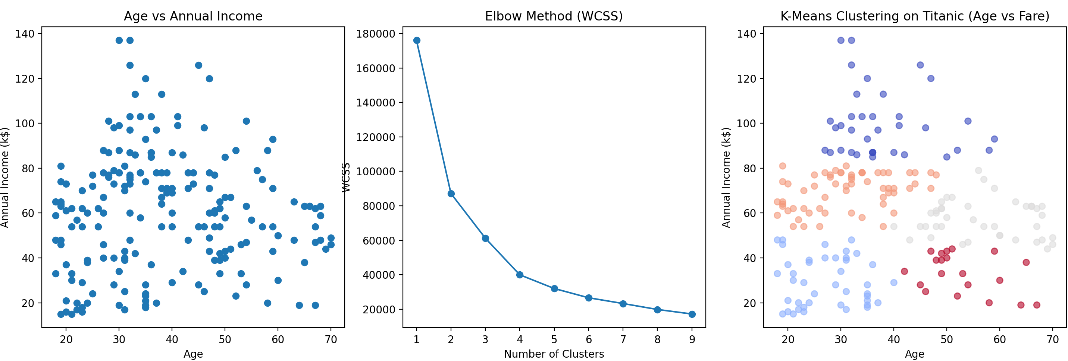
Result of Kmean clustering program

Slide 35
2.5 init in Kmeans
The KMeans algorithm works by: Choosing initial cluster centroids (starting points).
Assigning points to the nearest centroid: Updating centroids → repeat until convergence.
👉 The init parameter controls how the initial centroids are chosen.
This matters a lot because bad initialization can cause:
Poor clustering results
Slow convergence
Different results every time

Slide 36
2.5.1🔹 Common init Options in scikit-learn (k-means++)
1. init='k-means++' (default & recommended ✅)
Smart initialization method.
Picks centroids spread out from each other.
Reduces chances of poor clustering.
Faster convergence.
🔸 Example: If you want 2 clusters, it first picks 1 centroid randomly, then the 2nd one far away from it.

Slide 37
2.5.2 init='random'
2. init='random'
Chooses centroids randomly from the data points.
Very simple but can give poor results (clusters may overlap).
Sometimes requires multiple runs (n_init > 1) to get a good solution.

Slide 38
2.5.3 init=array
3. Custom Initialization (init=array)
You can pass a NumPy array of your own initial centroids.
Useful if you have prior knowledge about where clusters should start.
Example:
import numpy as np
initial_centroids = np.array([[30, 100], [50, 200]]) # Age, Fare example
kmeans = KMeans(n_clusters=2, init=initial_centroids, n_init=1)

Slide 39
2.5.4 init summary
init='k-means++’: Best balance, smarter initialization, avoids poor local minima (default).
init='random’: Simpler, but riskier (might give poor results).
init=array : You provide starting centroids manually.
⚠️ In scikit-learn, only these three are directly available.
But in research, there are advanced initialization methods like: Forgy method (random points as centroids), MacQueen method, Density-based seeding

Slide 40
3. Selecting Number of Clusters
🎯 Most important questions in clustering
How do we decide the best number of clusters (k) in KMeans?
Here are the common approaches:
Use Elbow Method for a quick guess.
Use Silhouette Score for validation.
Use Domain Knowledge when available.
KMeans doesn’t decide k → YOU must!

Slide 41
3.I. Elbow Method (most popular)
Plot Within-Cluster Sum of Squares (WCSS) vs K.
WCSS = how close points are to their cluster centroid (lower is better).
As k increases, WCSS decreases (clusters get tighter).
At some point, adding more clusters doesn’t improve much; looks like an elbow in the curve.
That “elbow point” is chosen as optimal K.

Slide 42
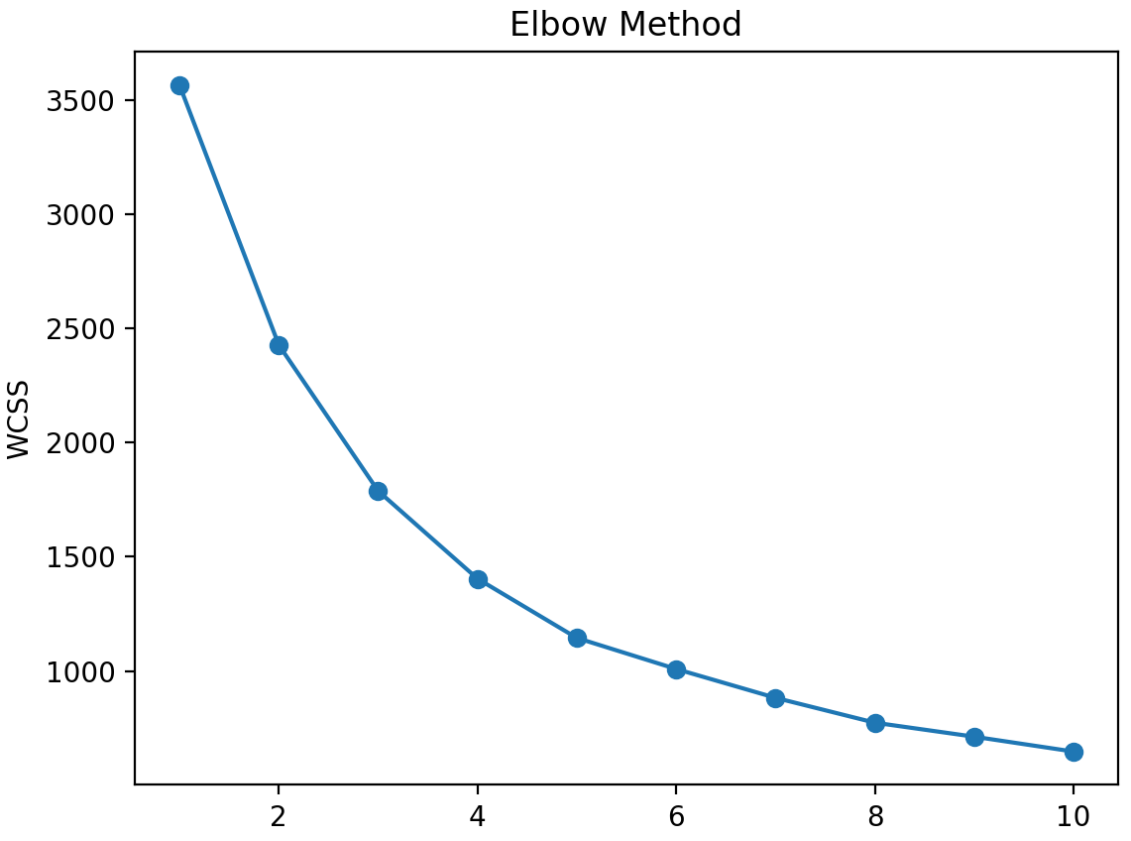
import pandas as pd
import matplotlib.pyplot as plt
from sklearn.cluster import KMeans
from sklearn.preprocessing import StandardScaler
url ='titanic.csv'
data = pd.read_csv(url)
df = data[['Pclass', 'Age', 'Fare', 'Sex']].copy()
df['Age'] = df['Age'].fillna(df['Age'].median())
df['Sex'] = df['Sex'].map({'male':0, 'female':1})
scaler = StandardScaler()
X = scaler.fit_transform(df)
wcss = []
for k in range(1, 11):
kmeans = KMeans(n_clusters=k, init='k-means++', random_state=42)
kmeans.fit(X)
wcss.append(kmeans.inertia_) # inertia_ = WCSS
plt.plot(range(1, 11), wcss, marker='o')
plt.title("Elbow Method")
plt.xlabel("Number of clusters (k)")
plt.ylabel("WCSS")
plt.show()
09_2_Kmean_Elbow_titanic.py
📌 Interpretation: Choose k at the “bend” (elbow).

Slide 43
How to Read the Elbow Method Plot
The Y-axis shows WCSS (Within-Cluster Sum of Squares) → lower means tighter clusters.
The X-axis shows k (number of clusters).
As k increases, WCSS decreases (because more clusters = smaller groups).
The goal is to find the “elbow point” — the point where WCSS stops dropping significantly (the curve bends).
k=1 → WCSS = very high (~3500)
k=2 → sharp drop (~2400)
k=3 → another drop (~1800)
k=4 → still dropping (~1400)
After k=4, the curve flattens out gradually (improvement slows down).
👉 The elbow point is around k=3 or k=4.
📌 Rule of Thumb: Choose the k where the slope change is maximum; after which adding more clusters gives diminishing returns.

Slide 44
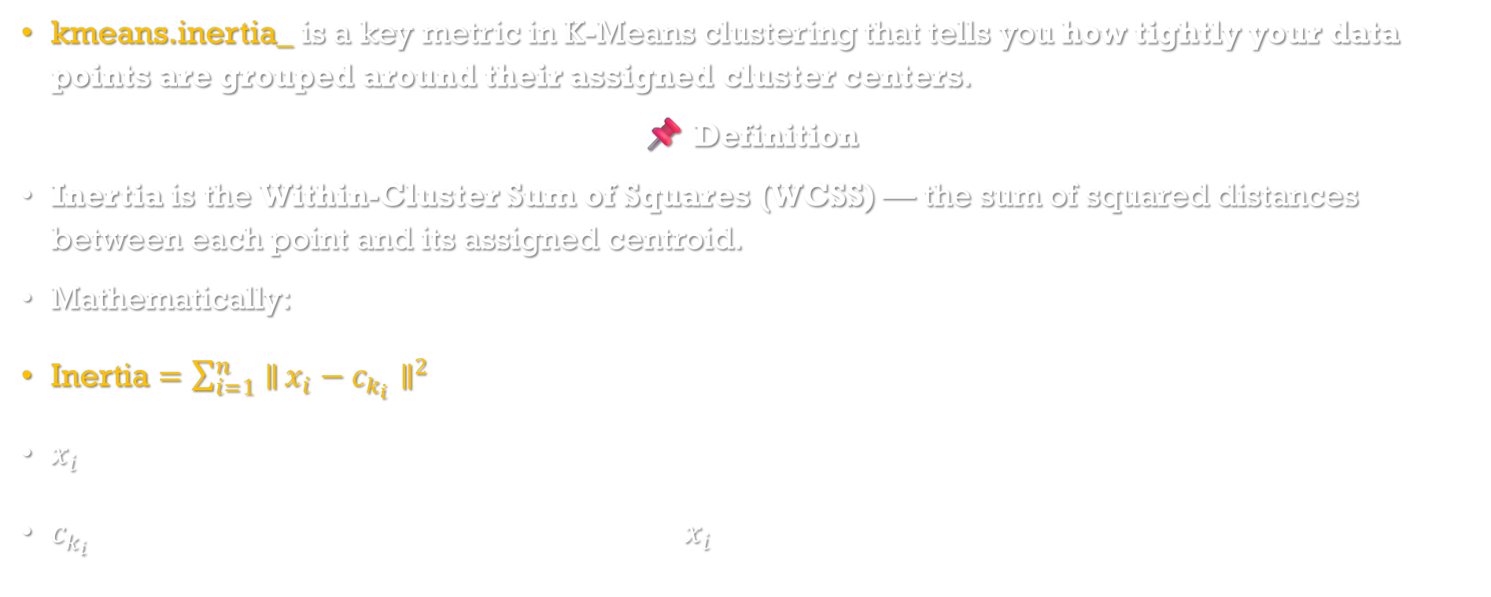
kmeans.inertia_
kmeans.inertia_ is a key metric in K-Means clustering that tells you how tightly your data points are grouped around their assigned cluster centers.
📌 Definition
Inertia is the Within-Cluster Sum of Squares (WCSS) — the sum of squared distances between each point and its assigned centroid.
Mathematically:
$\text{Inertia}=\sum_{i=1}^{n}{∥}x_{i}−c_{k_{i}}∥^{2}$ Where
$x_{i}$ is a data point
$c_{k_{i}}$ is the centroid of the cluster assigned to $x_{i}$.

Slide 45
📉 kmeans.inertia_ Why It Matters
Lower inertia means tighter clusters (better fit).
But lower isn’t always better — adding more clusters always reduces inertia, even if it doesn’t improve the model.
That’s why we use the Elbow Method: plot inertia vs number of clusters and look for the “elbow” point where improvement slows down.

Slide 46
3.II Silhouette Score
Measures how well each point fits within its cluster vs other clusters.
Silhouette Score (s) is: s= (b−a) / max⁡(a,b)
a = average distance to all other points in the same cluster
b = average distance to all points in the nearest neighboring cluster
The score ranges from -1 to +1:
+1 → perfect clustering (well-separated)
0 → overlapping clusters
-1 → wrong cluster assignment
Helps you choose the best number of clusters (k).
More reliable than inertia alone, especially when clusters vary in size or density.
Can be used with any clustering algorithm, not just Kmeans.

Slide 47
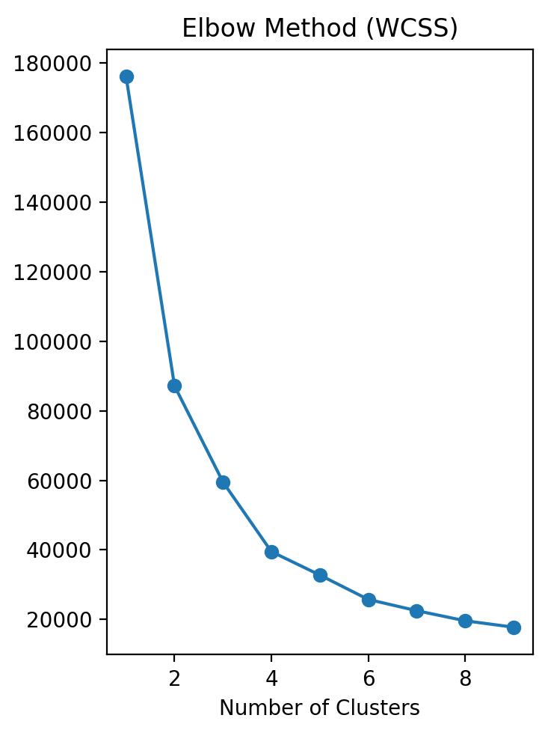
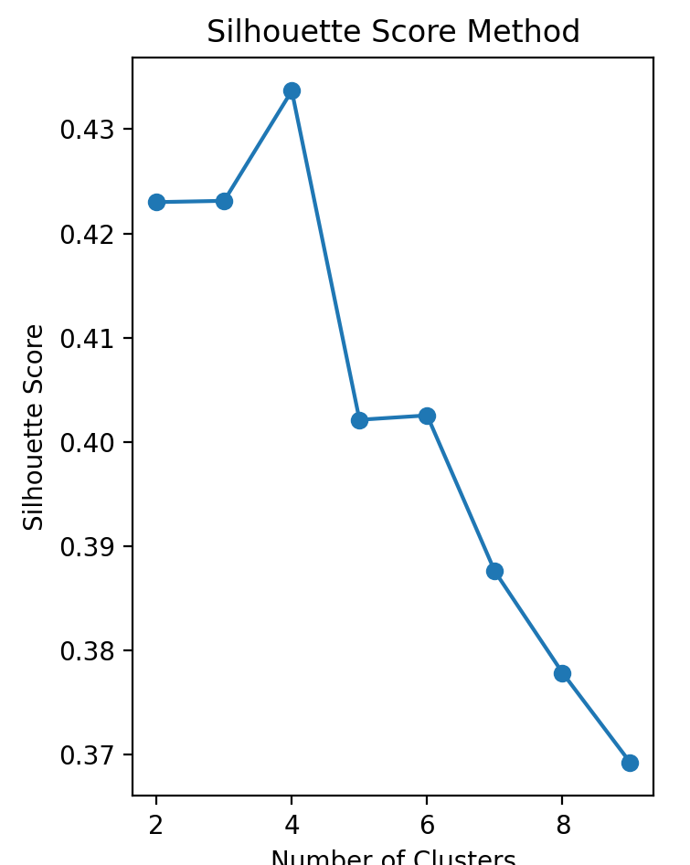
09_3_KMean_Silhout_wcss.py
from sklearn.cluster import KMeans
# 1. (WCSS):WITHIN CLUSTERS SUM OF SQUARES
cols = ['Age', 'Annual Income (k$)']
X = data[cols]
wcss=[]
for i in range(1,10):
km=KMeans(n_clusters=i,random_state=42)
km.fit(X)# 2D-single list of column names.
wcss.append(km.inertia_)
axes[1].plot(range(1,10),wcss, marker='o')
axes[1].set_title("Elbow Method (WCSS)")
axes[1].set_xlabel("Number of Clusters")
axes[1].set_ylabel("WCSS")
# 2. Silhouette Score
from sklearn.metrics import silhouette_score
sil_scores = []
for i in range(2, 10): # silhouette_score needs at least 2 clusters
km = KMeans(n_clusters=i, random_state=42)
labels = km.fit_predict(X)
score = silhouette_score(X, labels)
sil_scores.append(score)
axes[2].plot(range(2,10),sil_scores, marker='o')
axes[2].set_title("Silhouette Score Method")
axes[2].set_xlabel("Number of Clusters")
axes[2].set_ylabel("Silhouette Score")

Slide 48
Silhouette Score 🧪 09_4_Kmean_silhouette_score_cmd.py
from sklearn.cluster import KMeans
from sklearn.metrics import silhouette_score
cols = ['Age', 'Annual Income (k$)']
X = data[cols]
#wcss=[]
sil_scores = []
# Number of labels is 1. Valid values are 2 to n_samples - 1
for i in range(2,10):
km=KMeans(n_clusters=i)
#km.fit(X)# 2D-single list of column names.
labels = km.fit_predict(X)
score = silhouette_score(X, labels)
#wcss.append(km.inertia_)
sil_scores.append(score)
#axes[1].plot(range(1,10),wcss, marker='o')
axes[1].plot(range(2, 10), sil_scores, marker='x', label='Silhouette Score')
axes[1].set_title("Elbow Method (WCSS)")
axes[1].set_xlabel("Number of Clusters")
axes[1].set_ylabel("WCSS")

Slide 49
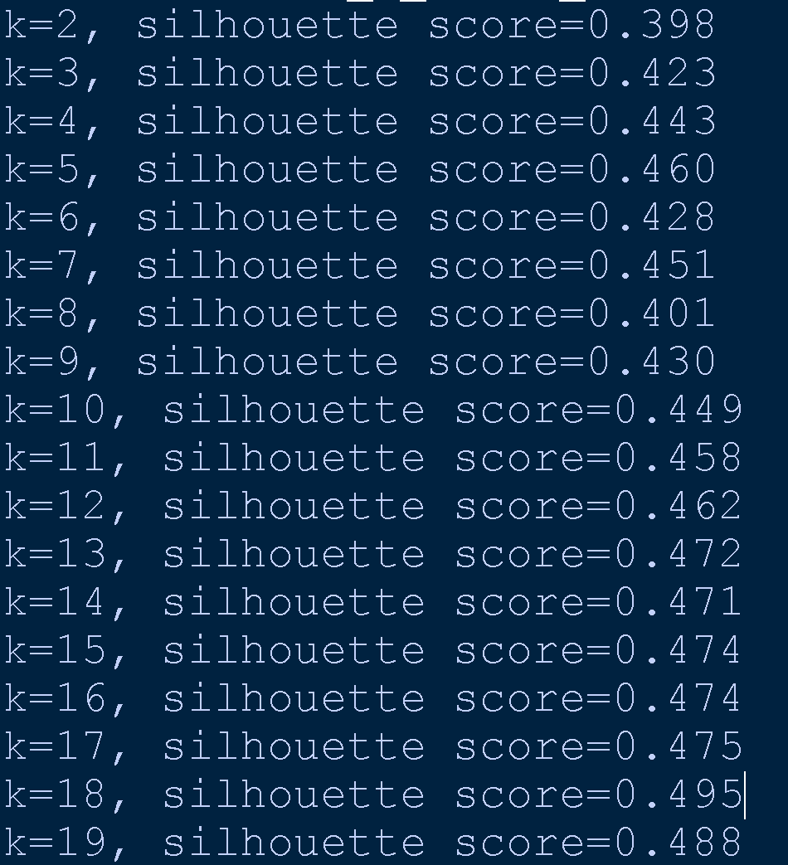
import pandas as pd
import matplotlib.pyplot as plt
from sklearn.cluster import KMeans
from sklearn.preprocessing import StandardScaler
url ='titanic.csv'
data = pd.read_csv(url)
# Step 2: Select & Preprocess Features
df = data[['Pclass', 'Age', 'Fare', 'Sex']].copy()
# Handle missing values
df['Age'] = df['Age'].fillna(df['Age'].median())
# Encode 'Sex' (male=0, female=1)
df['Sex'] = df['Sex'].map({'male':0, 'female':1})
# Feature scaling
scaler = StandardScaler()
X = scaler.fit_transform(df)
from sklearn.metrics import silhouette_score
for k in range(2, 20):
kmeans = KMeans(n_clusters=k, init='k-means++', random_state=42)
labels = kmeans.fit_predict(X)
score = silhouette_score(X, labels)
print(f"k={k}, silhouette score={score:.3f}")

Slide 50
Observations: silhouette score
k = 2 → 0.398 (weak separation, clusters not very good)
k = 3 → 0.423 (better, but still not strong)
k = 5 → 0.460 (improves)
k = 13 → 0.472
k = 18 → 0.495 (highest score)
So mathematically, k=18 gives the best silhouette score.
🔹 But Wait! (Practical Thinking 🧠)
It only tells you how compact & separated clusters are — not whether they make sense.
Having 18 clusters for Titanic data is not useful — it’s over-segmentation (too many small groups).
We usually want meaningful, interpretable clusters (e.g., 2 → survived vs not, or 3–5 → different passenger segments).

Slide 51
3.III Domain Knowledge
Gap Statistic (advanced)
Compares the total within-cluster variation with that expected from a random uniform distribution.
Best k is where the gap is largest.
Not directly in scikit-learn, but available in external libraries like gap-statistic.
Domain Knowledge
Sometimes, you already know how many groups make sense.
Example: In Titanic, survival is binary → k=2 is logical.
In customer segmentation, you might want 3 groups: high, medium, low value.

Slide 52
4. Hierarchical Clustering
Unlike KMeans (which needs you to pick k before clustering), hierarchical clustering builds a tree-like structure of clusters called a dendrogram
📌 Two main approaches:
Agglomerative (bottom-up) → Start with many small clusters, keep merging.
Divisive (top-down) → Start with one big cluster, keep splitting.

Slide 53
Hierarchical Clustering in Machine Learning
Hierarchical clustering is an unsupervised learning algorithm used to group unlabeled datasets into a cluster.
It is also known as hierarchical cluster analysis (HCA).
The algorithm builds a hierarchy of clusters in the form of a tree referred to as a dendrogram.
Hierarchical clustering and K-means clustering may produce similar results but differ in methodology.
Hierarchical clustering does not require the number of clusters to be predetermined, unlike K-means.
Notes:
As we already have other clustering algorithms such as K-Means Clustering, then why we need hierarchical clustering? So, as we have seen in the K-means clustering that there are some challenges with this algorithm, which are a predetermined number of clusters, and it always tries to create the clusters of the same size. To solve these two challenges, we can opt for the hierarchical clustering algorithm because, in this algorithm, we don't need to have knowledge about the predefined number of clusters.

Slide 54
4.1.1 approaches to hierarchical clustering
Agglomerative: Agglomerative is a bottom-up approach, in which the algorithm starts with taking all data points as single clusters and merging them until one cluster is left.
Divisive: Divisive algorithm is the reverse of the agglomerative algorithm as it is a top-down approach.

Slide 55
Feature | Agglomerative | Divisive
Starting point | Individual points | One large cluster
Process | Merges clusters | Splits clusters
Best for | Small to medium datasets | Large datasets
Outlier handling | Better | Can create separate clusters
Interpretability | More intuitive | Can be challenging

Slide 56
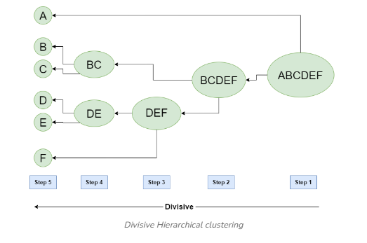
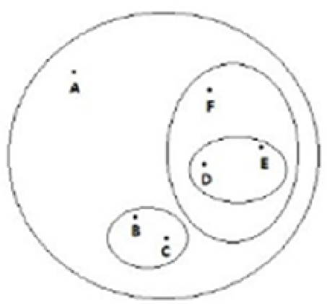
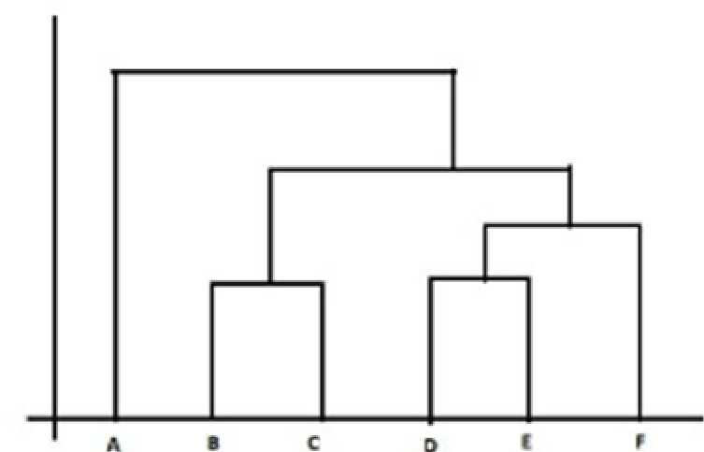
Dendrogram
The hierarchical clustering technique can be visualized using Dendrogram.
Dendrogram is a tree like diagram that records the sequences of merges or splits.

Slide 57
Agglomerative Clustering (Bottom-Up)
Begin with each data point as its own cluster.
Step by step, merge the closest clusters together.
Continue until everything becomes one big cluster.
You can “cut” the tree (dendrogram) at a certain level to decide number of clusters.
🔸 Example:
Imagine 6 passengers with features (Age, Fare).
Step 1: Each passenger is a cluster.
Step 2: Merge the two most similar passengers.
Step 3: Merge again until fewer clusters remain.
Finally: You get natural groupings like (wealthy older), (young poor), etc.
👉 Most commonly used in practice.
Scikit-learn supports Agglomerative Clustering, but Divisive Clustering isn't directly implemented

Slide 58
Hierarchical clustering does not require the number of clusters to be predetermined
The algorithm itself (especially in its raw form via scipy.linkage) builds a full hierarchy — a tree of merges or splits — without needing to know how many clusters you want (dendrogram).
You can explore the dendrogram and decide later how many clusters to extract by “cutting” the tree at a certain height.
So: the clustering process is flexible and exploratory — you don’t need to commit to a number upfront.
Conceptual Hierarchical Clustering | Practical AgglomerativeClustering
Builds full tree (dendrogram) | Only builds up to n_clusters
No need to predefine clusters | Requires n_clusters upfront
Flexible, exploratory | Fast, label-focused

Slide 59
🔗 4.2 Linkage Methods in Hierarchical Clustering
The linkage method defines how distances between clusters are calculated when merging them. Here are the main options: linked = linkage(X, method='ward')
Method | Description
'ward' | Minimizes the total within-cluster variance. Best for compact, spherical clusters.
'single' | Uses the minimum distance between points in two clusters (nearest neighbor).
'complete' | Uses the maximum distance between points in two clusters (farthest neighbor).
'average' | Uses the average distance between all pairs of points in two clusters.
'centroid' | Uses the distance between cluster centroids. Can produce inversions.
'median' | Similar to centroid but uses median. Less common.
🧠 Tip: 'ward' only works with Euclidean distance and is great for balanced clusters.

Slide 60
🔗 Linkage Methods contd…
1️⃣ Single Linkage (Minimum Distance): Distance between the closest pair of points in two clusters. linkage(X, method='single')
Effect: Can cause “chaining” — long, thin clusters.
Use case: Good for detecting elongated or irregular shapes.
2️⃣ Complete Linkage (Maximum Distance): Distance between the farthest pair of points in two clusters. linkage(X, method='complete')
Effect: Produces compact, spherical clusters.
Use case: Useful when you want tight clusters with small diameter.

Slide 61
3️⃣ Average Linkage (Mean Distance): Average of all pairwise distances between points in two clusters. linkage(X, method='average')
Effect: Balanced between single and complete linkage.
Use case: Works well when clusters vary in size and shape.
4️⃣ Centroid Linkage: Distance between the centroids (mean vectors) of two clusters. linkage(X, method='centroid')
Effect: Can cause inversions in dendrogram (clusters merge at lower distance than previous merges).
Use case: Useful when cluster centers are meaningful.

Slide 62
🧠 Summary Table: linkage
Linkage Type | Distance Used | Cluster Shape | Risk/Effect
Single | Closest point pair | Long, chained | Sensitive to noise
Complete | Farthest point pair | Compact, tight | May ignore structure
Average | Mean of all pairs | Balanced | Smooth transitions
Centroid | Between centroids | Center-based | Can invert merges

Slide 63
🌳 4.2.2. dendrogram() Function in scipy
Parameter | Purpose
linked | The linkage matrix (output of linkage() function).
ax=axes[0] | Specifies which subplot to draw the dendrogram on.
orientation='top' | Draws the dendrogram horizontally (top-down).
distance_sort='descending' | Sorts branches by descending distance (helps visualize longest merges first).
show_leaf_counts=False | Hides the number of original samples in each leaf node.
labels | Custom labels for leaf nodes.
color_threshold | Controls where color changes in branches (based on distance).
truncate_mode | Limits the depth of the tree (e.g., 'lastp' to show only last p merges).
linked = linkage(X, method='ward')
dendrogram(linked, ax=axes[0], orientation='top', distance_sort='descending', show_leaf_counts=False)

Slide 64
Python : 09_5_Agglomerative_income.py
import pandas as pd
import matplotlib.pyplot as plt
from sklearn.cluster import AgglomerativeClustering
from scipy.cluster.hierarchy import dendrogram, linkage
# Load dataset
data = pd.read_csv("Mall_Customers.csv")
X = data[['Age', 'Annual Income (k$)']]
# Create figure with 3 subplots
fig, axes = plt.subplots(1, 2, figsize=(18, 5))
# 1️⃣ Dendrogram to choose number of clusters
linked = linkage(X, method='ward')
dendrogram(linked, ax=axes[0], orientation='top', distance_sort='descending', show_leaf_counts=False)
axes[0].set_title("Dendrogram for Agglomerative Clustering")
axes[0].set_xlabel("Customers")
axes[0].set_ylabel("Euclidean Distance")

Slide 65
Code contd…
# 2️⃣ Apply Agglomerative Clustering
agg = AgglomerativeClustering(n_clusters=4, linkage='ward')
data['AggCluster'] = agg.fit_predict(X)
# 3️⃣ Visualize Clusters
axes[1].scatter(data['Age'], data['Annual Income (k$)'], c=data['AggCluster'], cmap='Set1', alpha=0.6)
axes[1].set_title("Agglomerative Clustering (Age vs Income)")
axes[1].set_xlabel("Age")
axes[1].set_ylabel("Annual Income (k$)")
# Final layout
plt.tight_layout()
plt.show()

Slide 66
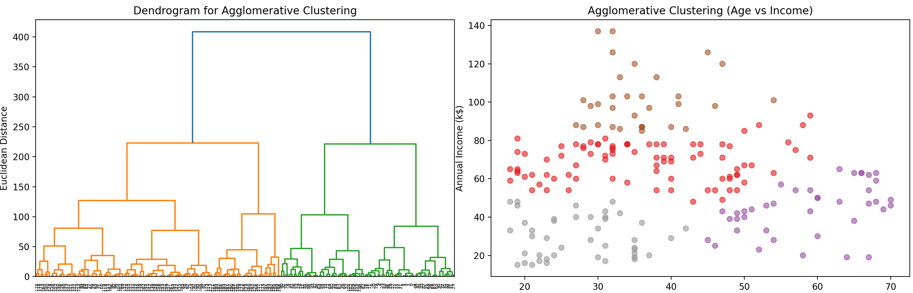
output

Slide 67
unsupervised algorithms like K-Means don’t have a traditional “error rate” like supervised models do.
There's no ground truth to compare against. But we can still measure how well the clustering performs using internal and external metrics.

Slide 68
🧠 4.2.3 Why “Error Rate” Doesn’t Apply Directly
In supervised learning, error rate = wrong predictions / total predictions.
In unsupervised clustering, we don’t know the “correct” cluster labels — so we can’t count errors.
Instead, we measure how compact and well-separated the clusters are.
Metric | Best For | Interpretation
Silhouette Score | General cluster quality | Higher = better
Inertia (WCSS) | Compactness & separation | Lower = better

Slide 69
09_6_Kmean_Agglomerative_titanic.py
import pandas as pd
import matplotlib.pyplot as plt
from sklearn.cluster import KMeans
from sklearn.preprocessing import StandardScaler
url ='titanic.csv'
data = pd.read_csv(url)
# Step 2: Select & Preprocess Features
df = data[['Pclass', 'Age', 'Fare', 'Sex']].copy()
# Handle missing values
df['Age'] = df['Age'].fillna(df['Age'].median())
# Encode 'Sex' (male=0, female=1)
df['Sex'] = df['Sex'].map({'male':0, 'female':1})
# Feature scaling
scaler = StandardScaler()
X = scaler.fit_transform(df)

Slide 70
from sklearn.cluster import AgglomerativeClustering
from scipy.cluster.hierarchy import dendrogram, linkage
# Agglomerative clustering
agg = AgglomerativeClustering(n_clusters=3, linkage='ward')
labels = agg.fit_predict(X)
# Add labels back
df['Cluster'] = labels
# Scatter plot with 2 subplots
fig, axes = plt.subplots(1, 2,figsize=(14,6))
import seaborn as sns
sns.scatterplot(x=df['Age'], y=df['Fare'], hue=df['Cluster'], palette='Set1', ax=axes[0])
axes[0].set_title("Agglomerative Clustering (Titanic: Age vs Fare)")
# Dendrogram
Z = linkage(X, method='ward')
dendrogram(Z, truncate_mode="lastp", p=20, ax=axes[1])
axes[1].set_title("Dendrogram (Agglomerative Clustering)")
axes[1].set_xlabel("Sample Index")
axes[1].set_ylabel("Distance")
plt.tight_layout()
plt.show()

Slide 71
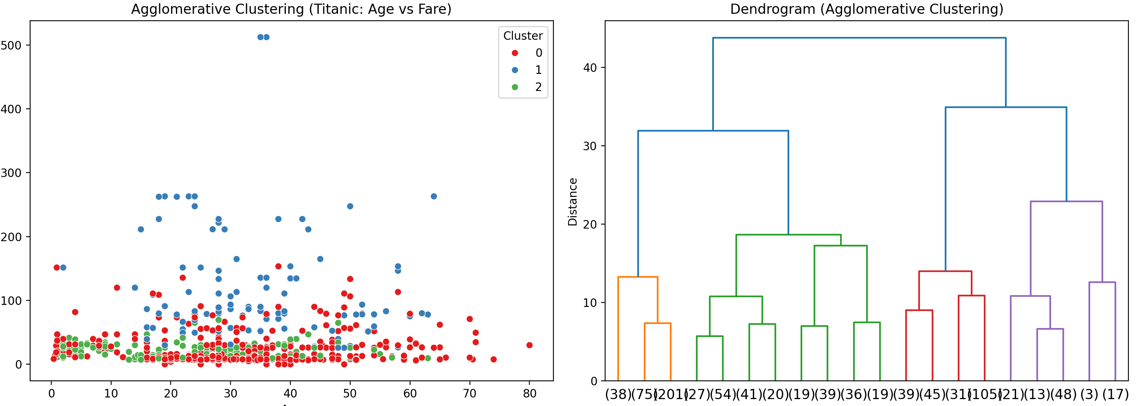
🔢 What Do the Numbers Below the Dendrogram Represent?
These numbers are indices of data points - they correspond to the row numbers in your dataset.
For example, if you see 42 under a leaf node, it means that point is X.iloc[42].
They are not cluster labels - they’re just identifiers for individual observations.
🌳 How Merging Works in a Dendrogram:
A dendrogram shows the step-by-step merging of clusters in Agglomerative Clustering (bottom-up).
🧩 Step-by-Step Merger Process
Start with each point as its own cluster.
Find the two closest clusters (based on linkage method: ward, single, etc.).
Merge them into a new cluster.
Repeat steps 2–3 until all points are merged into one big cluster.
📐 Vertical Lines = Merges
Each vertical line represents a merge between clusters.
The height of the line = distance (or dissimilarity) between merged clusters.
Shorter lines = more similar clusters.
Longer lines = less similar (merged later).

Slide 72
🧠 Divisive Clustering
Think of it like splitting a big group into smaller groups step by step:
Start with everyone in one cluster.
Find the biggest or most diverse group, and split it into two.
Repeat until you have the number of clusters you want.
This is the opposite of Agglomerative Clustering, which starts with individuals and merges them.
🧪 Scikit-learn supports Agglomerative Clustering, but Divisive Clustering isn't directly implemented:
we simulate it by use of KMeans with 2 clusters repeatedly to split the biggest group.

Slide 73
09_7_Divisive Clustering.py
import pandas as pd
import matplotlib.pyplot as plt
from sklearn.cluster import KMeans
# Load data
data = pd.read_csv("Mall_Customers.csv")
X = data[['Age', 'Annual Income (k$)']]
# Start with all points in one cluster
labels = [0] * len(X) # Everyone starts in cluster 0
clusters = {0: X.copy()} # Dictionary to hold cluster data
next_label = 1 # Label for the next new cluster

Slide 74
while len(clusters) < 4: # Keep splitting until we have 4 clusters
# Find the largest cluster to split
largest = max(clusters, key=lambda k: len(clusters[k]))
data_to_split = clusters.pop(largest)
km = KMeans(n_clusters=2, random_state=42) # Apply KMeans with 2 clusters
split = km.fit_predict(data_to_split)
# Assign new labels
idx = data_to_split.index
for i, point in enumerate(idx):
if split[i] == 0:
labels[point] = largest # Keep old label
else:
labels[point] = next_label # Assign new label
# Save new clusters
clusters[largest] = data_to_split[split == 0]
clusters[next_label] = data_to_split[split == 1]
next_label += 1

Slide 75
# Add labels to data
data['DivCluster'] = labels
# Plot result
# Define your custom colors (must match number of clusters)
from matplotlib.colors import ListedColormap
custom_colors = ListedColormap(['red', 'blue', 'green', 'purple'])
plt.figure(figsize=(8, 6))
plt.scatter(data['Age'], data['Annual Income (k$)'], c=data['DivCluster'], cmap=custom_colors, alpha=0.6)
plt.title("Simulated Divisive Clustering")
plt.xlabel("Age")
plt.ylabel("Annual Income (k$)")
plt.show()

Slide 76
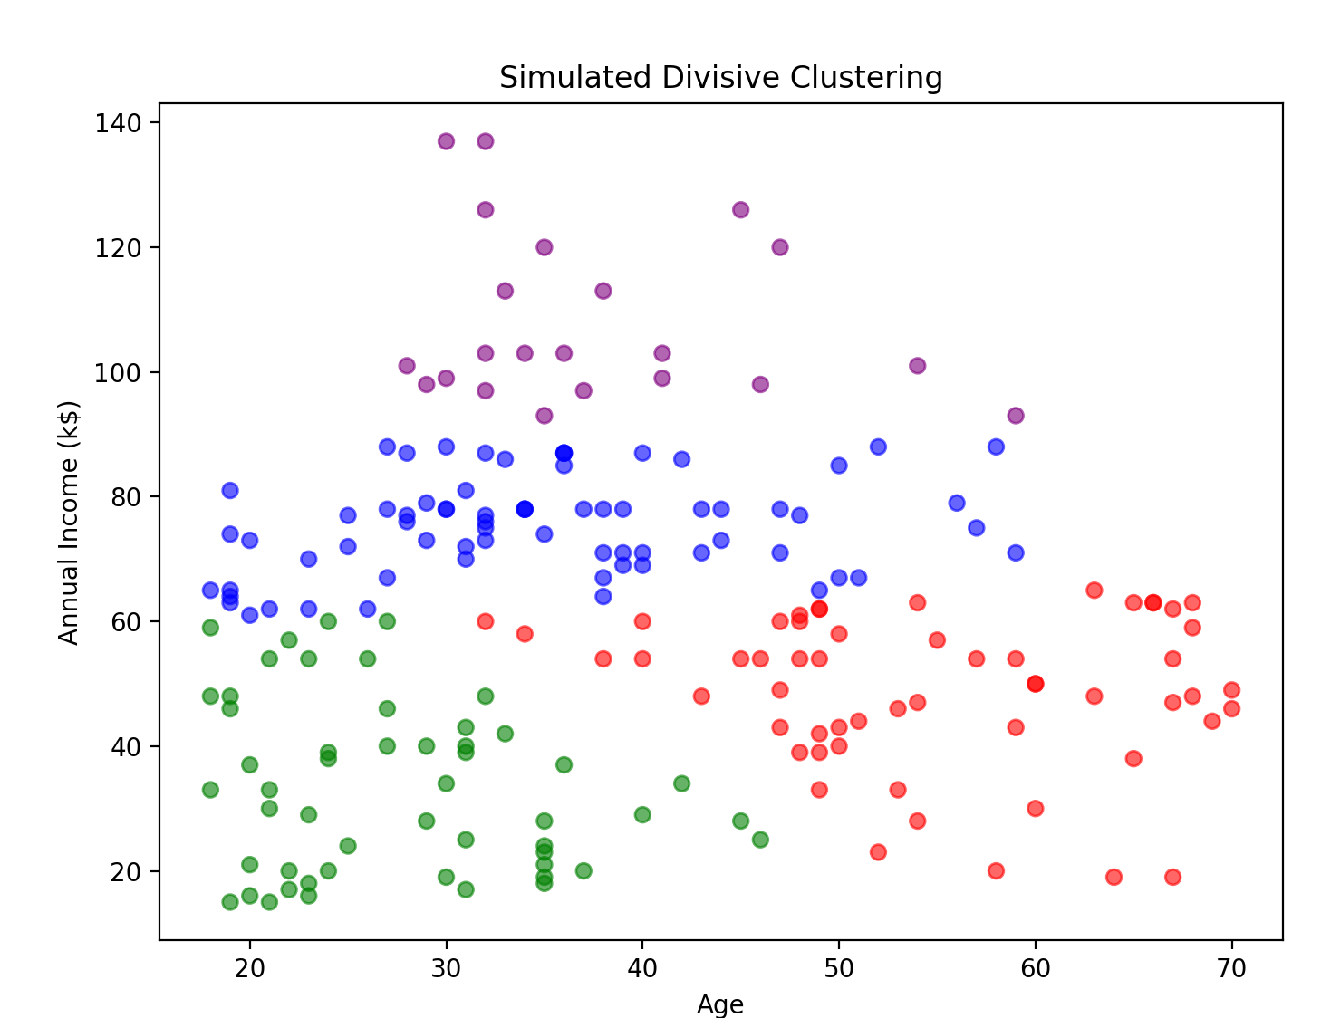

Slide 77
5. Association Rules
Think back to the last time you made an impulse purchase. Maybe you were waiting in the grocery store checkout lane and bought a pack of chewing gum or a candy bar.
You might have even bought a book on a whim on a bookseller's recommendation.
These impulse buys are no coincidence, as retailers use sophisticated data analysis techniques to identify patterns that will drive retail behavior.

Slide 78
In years past, such recommendation systems were based on the subjective intuition of marketing professionals and inventory managers or buyers.
More recently, as barcode scanners, computerized inventory systems, and online shopping trends have built a wealth of transactional data, machine learning has been increasingly applied to learn purchasing patterns.
The practice is commonly known as market basket analysis due to the fact that it has been so frequently applied to supermarket data.

Slide 79
Association Rules
The building blocks of a market basket analysis are the items that may appear in any given transaction.
Groups of one or more items are surrounded by brackets to indicate that they form a set, or more specifically, an itemset that appears in the data with some regularity.
Transactions are specified in terms of item-sets, such as the following transaction that might be found in a typical grocery store:
{bread ,peanut butter, jelly}
Notes:
Association Rules are widely used to analyze retail basket or transaction data, and are intended to identify strong rules discovered in transaction data using measures of interestingness

Slide 80
Association rules are always composed from subsets of item-sets and are denoted by relating one item-set on the left-hand side (LHS) of the rule to another item-set on the right-hand side (RHS) of the rule.
The LHS is the condition that needs to be met in order to trigger the rule, and the RHS is the expected result of meeting that condition. A rule identified from the example transaction might be expressed in the form:
{peanut butter, jelly} => {bread}
In plain language, this association rule states that if peanut butter and jelly are purchased together, then bread is also likely to be purchased.
In other words, "peanut butter and jelly imply bread.“

Slide 81
Association rule learners are unsupervised; there is no need for the algorithm to be trained; data does not need to be labeled ahead of time.
The program is simply unleashed on a dataset in the hope that interesting associations are found.
Although association rules are most often used for market basket analysis, they are helpful for finding patterns in many different types of data.
Other potential applications include:
Searching for interesting and frequently occurring patterns of DNA and protein sequences in cancer data
Finding patterns of purchases or medical claims that occur in combination with fraudulent credit card or insurance use
Identifying combinations of behavior that precede customers dropping their cellular phone service or upgrading their cable television package

Slide 82
🧠 Association Rules
Association rules help us find patterns in data — especially in shopping behavior.
Imagine you're looking at thousands of shopping carts and asking:
“If someone buys bread and butter, how likely are they to also buy jam?”
This is called Market Basket Analysis — and it’s used by stores to:
    Suggest products (“People who bought X also bought Y”)
    Organize shelves
    Create combo offers

Slide 83
🛒 Real-Life Example: Grocery Store
Transaction | Items Bought
1 | Milk, Bread, Butter
2 | Bread, Butter
3 | Milk, Bread
4 | Milk, Bread, Butter, Jam
5 | Bread, Jam
We want to find rules like:
Bread → Butter (If someone buys bread, they often buy butter)
Milk & Bread → Jam (If someone buys milk and bread, they might buy jam)

Slide 84
📊 There are three common ways to measure association.
Term | Meaning
Support | How often the items appear together in all transactions.
Confidence | How often the rule is true (e.g., Bread → Butter).
Lift | How much more likely the items are bought together than randomly.
Let Us see one by one

Slide 85
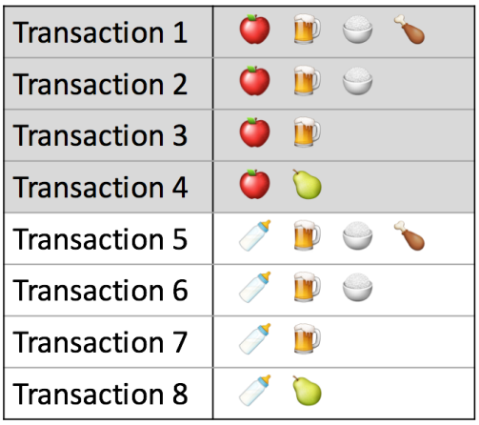

Measure 1: Support
This says how popular an itemset is, as measured by the proportion of transactions in which an itemset appears.
In the figure, the support of {apple} is 4 out of 8, or 50%. Item-sets can also contain multiple items.
For instance, the support of
  {apple, beer, rice} is 2 out of 8, or 25%.
Source: https://www.kdnuggets.com/2016/04/association-rules-apriori-algorithm-tutorial.html

Slide 86
Applying the “support threshold as the proportion beyond which items matter” idea
If you discover that sales of certain items beyond a specific proportion significantly impact profits.
Use that proportion as the support threshold.
Find item-sets with support values above the threshold.
Consider these item-sets as significant item-sets for analysis or decision-making.

Slide 87
Step | Description in general | Example
Decide a “critical proportion” | You notice that itemsets whose frequency is above p tend to influence profit or decisions. So you choose p as your minimum support threshold. | Suppose you decide that any itemset that occurs in at least 25% of transactions is “significant” (i.e. support threshold = 0.25).
Compute support for all itemsets | For each possible itemset, compute how often (in what proportion of transactions) it appears. | In the example, they compute supports like support({apple}) = 0.50, support({apple, beer, rice}) = 0.25, etc.
Select those itemsets whose support ≥ threshold | Filter the computed itemsets to keep only those with support ≥ p. These become your “significant itemsets.” | With threshold = 0.25, {apple}, {apple, beer, rice}, and other itemsets that have support ≥ 0.25 would be kept. For instance, {apple} with support 0.50 would qualify.
Use those significant itemsets for further analysis | Once you have this narrowed-down set, you can compute confidence, lift, or generate actual association rules only from them. | After they identify frequent itemsets (above min support), they use them further to derive association rules and compute confidence, lift, etc.

Slide 88

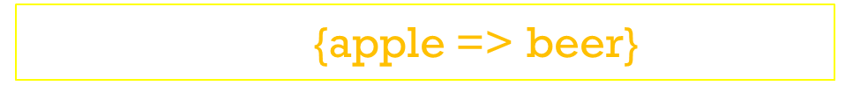
Measure 2: Confidence
This says how likely item Y is purchased when item X is purchased, expressed as {X -> Y}.
This is measured by the proportion of transactions with item X, in which item Y also appears.
In figure, the confidence of
{apple => beer} is 3 out of 4, or 75%.
confidence of {apple => beer}$=\frac{3}{4}$ =0.75

Slide 89
One drawback of the confidence measure is that it might misrepresent the importance of an association.
This is because it only accounts for how popular apples are, but not beers.
If beers are also very popular in general, there will be a higher chance that a transaction containing apples will also contain beers, thus inflating the confidence measure.
To account for the base popularity of both constituent items, we use a third measure called lift.

Slide 90

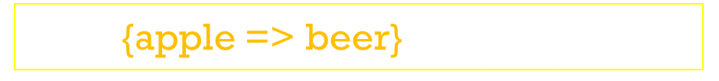
Measure 3: Lift
This says how likely item Y is purchased when item X is purchased, while controlling for how popular item Y is.
In figure, the lift of {apple -> beer} is 1,which implies no association between items.
A lift value greater than 1 means that item Y is likely to be bought if item X is bought, while a value less than 1 means that item Y is unlikely to be bought if item X is bought.
lift of {apple => beer}$=\frac{3}{4∗6}$ = $\frac{1}{8}$ =0.125

Slide 91
Example
Support(Bear) = 6 / 8 = 0.75
Support(Rice) = 4 / 8 = 0.5
Support(Bear ∩ Rice) = 4 / 8 = 0.5
Confidence (Bear → Rice)= Support(Bear ∩ Rice) / Support(Bear) = 0.5 / 0.75 = 0.6667
Lift = Confidence / Support(Rice)
= 0.6667 / 0.5 = 1.3333
✅ Final Rule Interpretation:
If someone buys Bear, they are 66.7% likely to also buy Rice.
This is 1.33× more likely than random chance.
transactions = [
['Apple', Beer', 'Rice', 'Chicken'],
['Apple', Beer', 'Rice'],
['Apple', Beer'],
['Apple', 'Pear'],
['Milk', Beer', 'Rice', 'Chicken'],
['Milk', Beer', 'Rice'],
['Milk', Beer'],
['Milk', 'Pear']
]

Slide 92
MLxtend (Machine Learning Extensions)
MLxtend (Machine Learning Extensions) is a Python library that provides a collection of useful tools and utilities for various machine learning and data science tasks.
It extends the functionality of popular libraries like scikit-learn, NumPy, and pandas by offering features not readily available in those packages.
pip install mlxtend

Slide 93
🧠 What Is Apriori?
Apriori is an algorithm used to find patterns in data — especially in market basket analysis. It helps answer questions like:
“If someone buys bread and butter, how likely are they to also buy jam?”
It’s called Apriori because it uses the idea of “prior knowledge” — if a combination of items is frequent, then all its subsets must also be frequent.

Slide 94
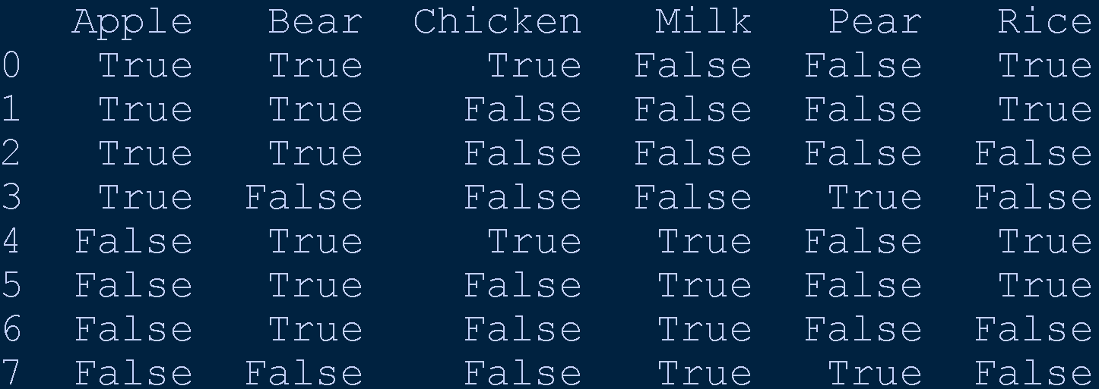
# Install first: pip install mlxtend
from mlxtend.frequent_patterns import apriori, association_rules
from mlxtend.preprocessing import TransactionEncoder
import pandas as pd
# Sample data
transactions = [
['Apple', Beer', 'Rice','Chicken'],
['Apple', Beer', 'Rice'],
['Apple', Beer'],
['Apple', 'Pear'],
['Milk', Beer', 'Rice','Chicken'],
['Milk', Beer', 'Rice'],
['Milk', Beer'],
['Milk', 'Pear'],
]
# Step 1: Convert to one-hot encoded DataFrame
te = TransactionEncoder()
te_array = te.fit(transactions).transform(transactions)
df = pd.DataFrame(te_array, columns=te.columns_)
print(df)
mlxtend library Syntax: one-hot encoded format, which is often required for algorithms like the Apriori algorithm

Slide 95
apriori(df, min_support=0.4, use_colnames=True)
min_support (2nd parameter) : The minimum support threshold for an itemset to be considered “frequent.”
Support is the proportion of transactions that contain the itemset.
Example: If min_support=0.4, then only item-sets that appear in at least 40% of transactions will be kept.
🔍 Why it matters:
Helps filter out rare combinations.
Keeps the focus on patterns that are statistically significant.
Filters item-sets that appear in ≥ 40% of transactions.
📛 use_colnames (3rd parameter) :Whether to show item-sets using actual item names instead of column indices.
Default is False, which returns itemsets like {0, 1}.
When set to True, it returns itemsets like {'Bread', 'Butter'}.
🔍 Why it matters:
Makes the output human-readable.
Essential for interpreting and visualizing rules.
Displays itemsets using actual item names (like 'Milk', 'Bread').

Slide 96
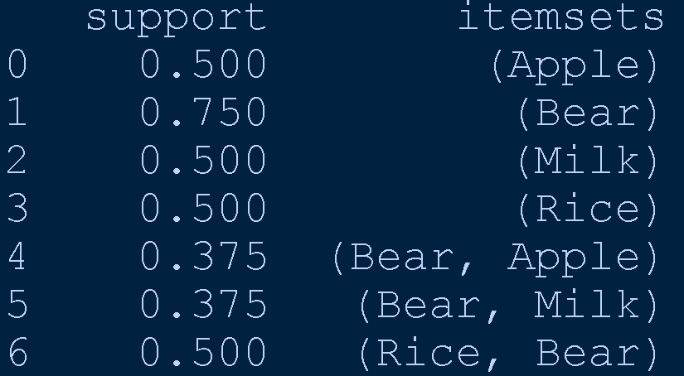
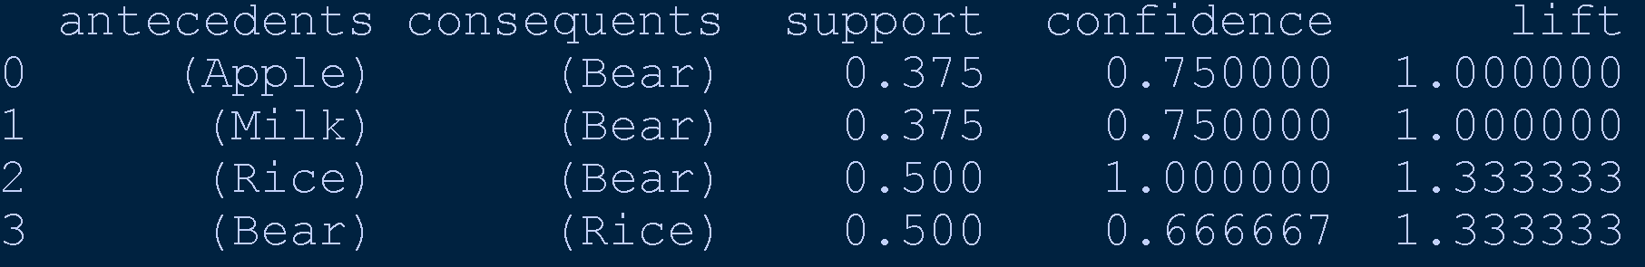
# Step 2: Find frequent itemsets
frequent_itemsets = apriori(df, min_support=0.3, use_colnames=True)
print(frequent_itemsets)
# Step 3: Generate association rules
rules = association_rules(frequent_itemsets, metric="confidence", min_threshold=0.6)
# Show results
print(rules[['antecedents', 'consequents', 'support', 'confidence', 'lift']])
Association rule generation tries both directions. For {Bear, Milk},
the algorithm will consider both: {Bear} → {Milk} {Milk} → {Bear}
Then it computes confidence for each direction.

Slide 97
Rule | support(A∪B) | support(A) | confidence
{Milk} → {Bear} | 0.375 | 0.50 | 0.375 / 0.50 = 0.75 ✅ (passes min_threshold = 0.6)
{Bear} → {Milk} | 0.375 | 0.75 | 0.375 / 0.75 = 0.5 ❌ (below 0.6, gets filtered out)

Slide 98
Frequent Itemset | Possible Rules | Confidence | ≥ 0.6 ? | Shown in Output?
{Apple, Bear} | Apple → Bear | 0.75 | ✅ | ✅
 | Bear → Apple | 0.5 | ❌ | ❌
{Milk, Bear} | Milk → Bear | 0.75 | ✅ | ✅
 | Bear → Milk | 0.5 | ❌ | ❌
{Bear, Rice} | Bear → Rice | 0.67 | ✅ | ✅
 | Rice → Bear | 1.0 | ✅ | ✅

Slide 99
rules = association_rules(frequent_itemsets, metric="confidence", min_threshold=0.6)
Metric | Filters Based On… | Typical Use Case
Confidence | Predictive strength of the rule | “If A, how likely is B?”
Support | Frequency of the full rule (A ∩ B) | “How common is this combo overall?”
Lift | Strength of association compared to chance | “Is A → B more likely than random co-occurrence?”

Slide 100
column in the association rules
Column | Meaning
antecedents | Items on the left side of the rule (e.g., Bread)
consequents | Items on the right side of the rule (e.g., Butter)
antecedent support | How often the antecedent appears in all transactions
consequent support | How often the consequent appears in all transactions
support | How often both items appear together
confidence | Probability of buying consequent given antecedent
lift | How much more likely the items are bought together than randomly
representativity | How well the rule represents the dataset (higher = more representative)
leverage | Difference between actual and expected co-occurrence
conviction | How strongly the antecedent implies the consequent
zhangs_metric | A balanced measure of rule strength (between -1 and +1)
jaccard | Similarity between antecedent and consequent sets
certainty | How certain the rule is, based on confidence and lift
kulczynski | Average confidence of both directions (A→B and B→A)

Slide 101
Finding Patterns from the Association Rules
🔍 1. Look for High Confidence Rules
These are strong predictors. For example:
Milk → Rice with confidence 0.75 → 75% of Milk-buyers also bought Rice
Use case: Product bundling, personalized recommendations.
📈 2. Check Lift > 1
Lift tells you if the rule is better than random chance.
Bear → Rice with lift 1.33 → Buying Bear makes Rice 33% more likely than random
Use case: Discover surprising or non-obvious associations

Slide 102
Market Basket Analysis (MBA)
Market Basket Analysis is used to find relationships between products that customers buy together.
It’s the basis of recommendation systems used by Amazon, Flipkart, and supermarkets.
🧠 Example:
If customers often buy Bread and Butter together, then when someone buys Bread, the system recommends Butter.
IF {Bread} THEN {Butter}
👉 Real-World Uses
Recommending items (“People who bought X also bought Y”)
Cross-selling in e-commerce or supermarkets
Analyzing purchase behavior

Slide 103
Term | Meaning | Formula
Itemset | A collection of one or more items. | Example: {Bread, Butter}
Support | How often the rule appears in the dataset. | Support(A→B) = (Transactions containing A ∪ B) / Total transactions
Confidence | How often B is bought when A is bought. | Confidence(A→B) = Support(A∪B) / Support(A)
Lift | How much more likely B is bought when A is bought (compared to random chance). | Lift(A→B) = Confidence(A→B) / Support(B)

